Slide 2
Angle Head Half assembly
&
mini
Notes:
デモ
30”
(30”)

Slide 3
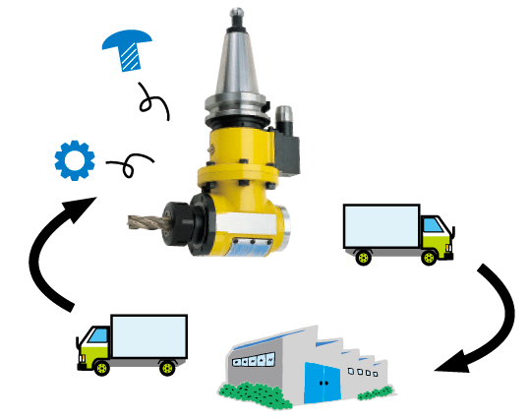
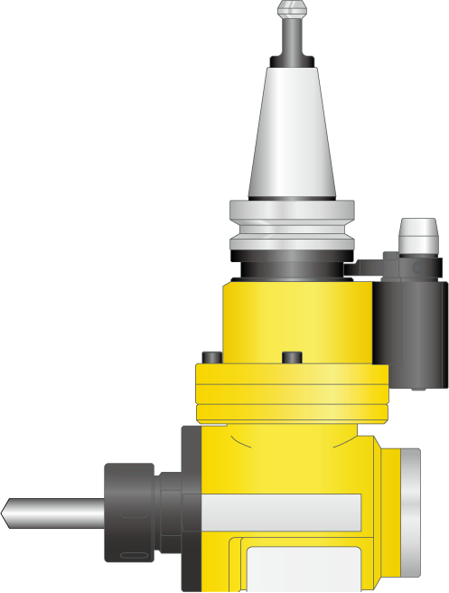
Difficulties for the existing Angle Head
Taking time
Expensive
repair cost
Manufacturer repair

Slide 4
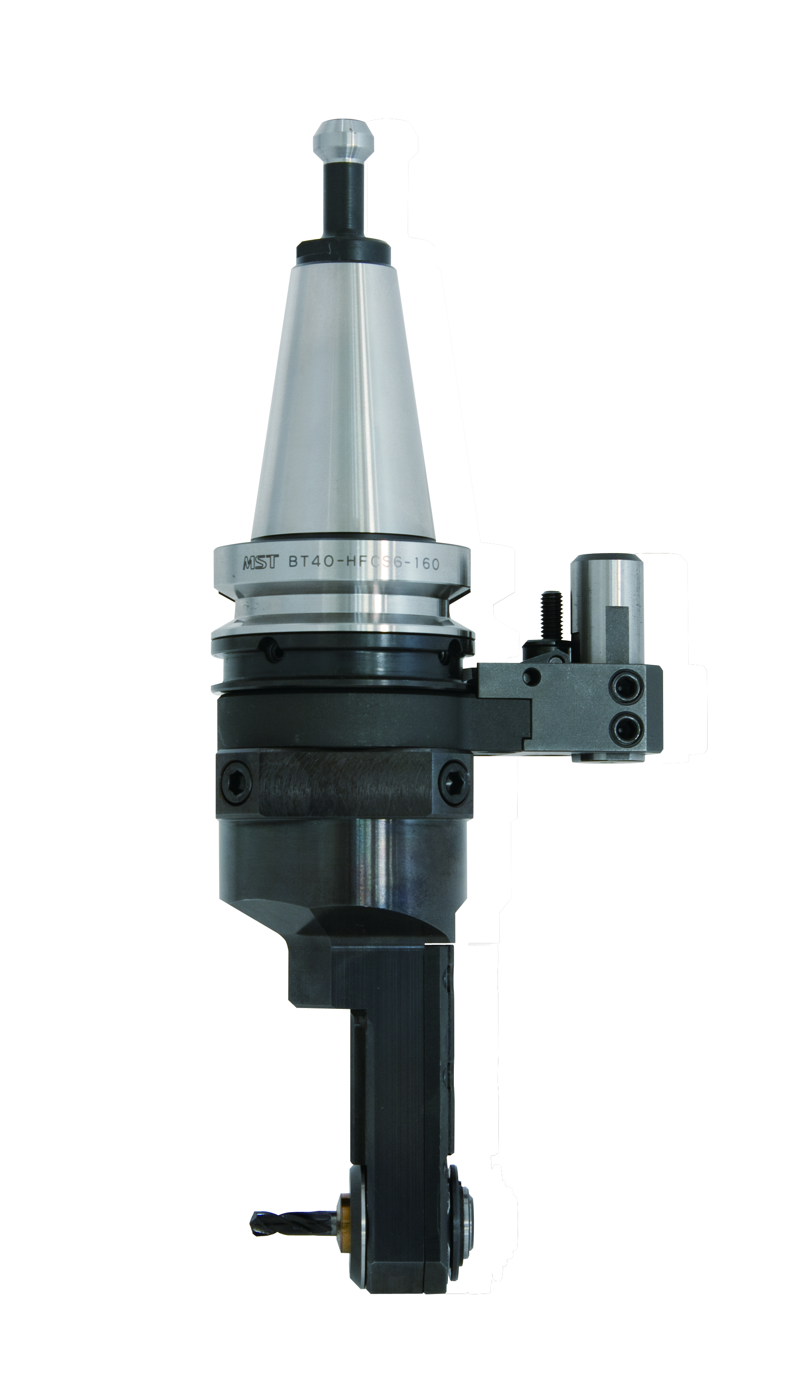
Angle Head Half
Repair
yourself !
Easy
Assembly !

Slide 5
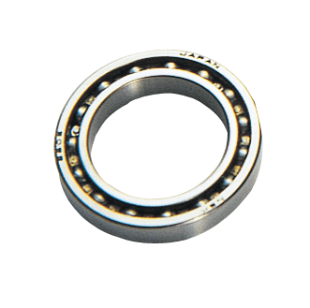
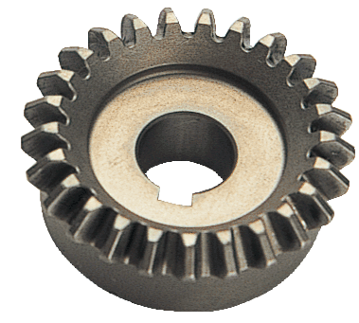
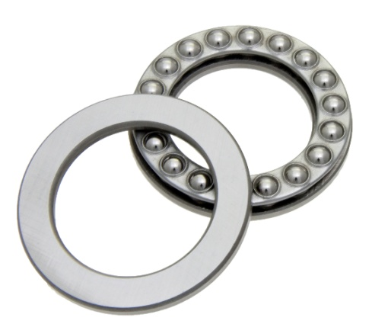
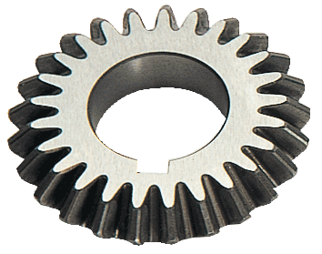
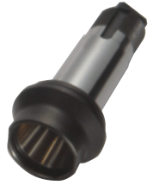
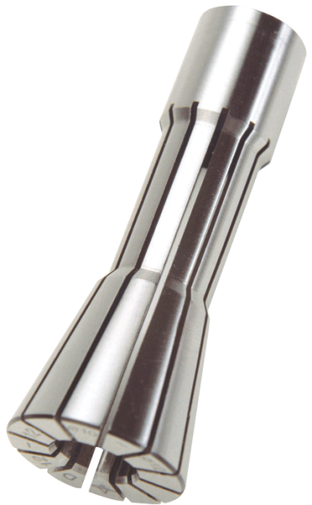
Bearing
Gear
Angle Shaft
Collet

Slide 6
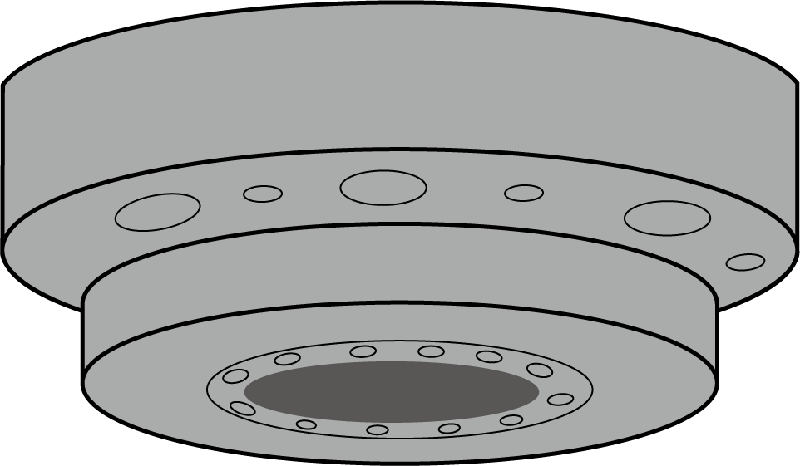
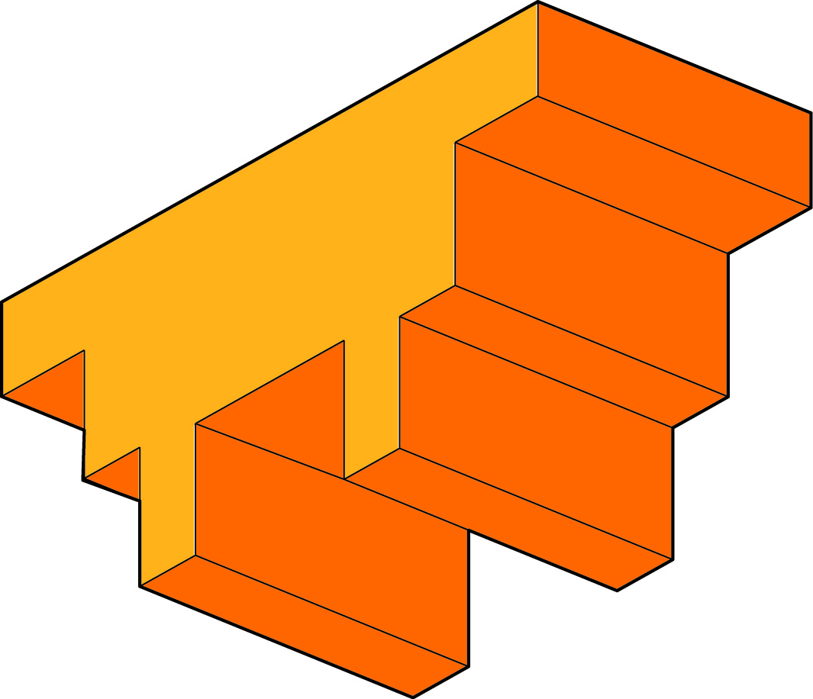
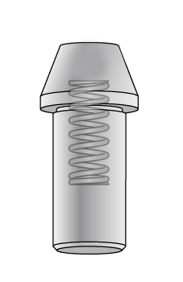
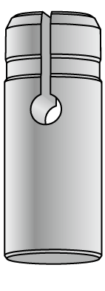
Positioning block
Three kinds oｆ Positioning pin
Notes:
30”
(30”)

Slide 7
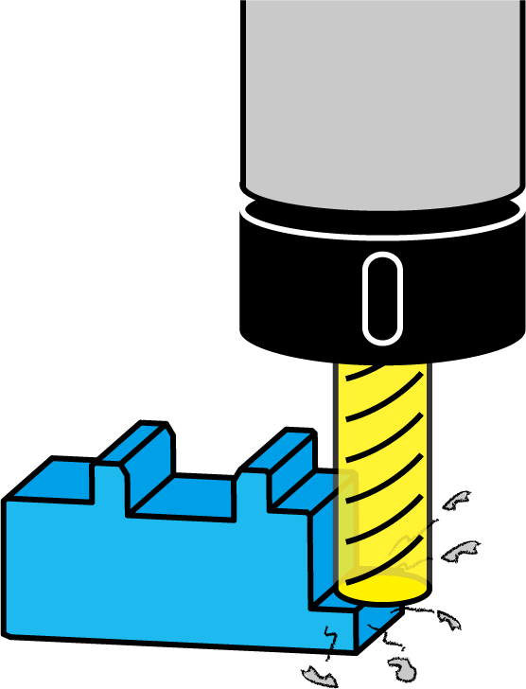
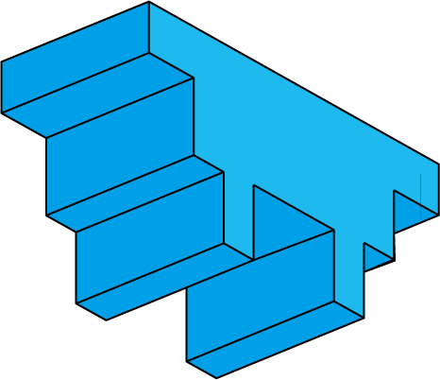
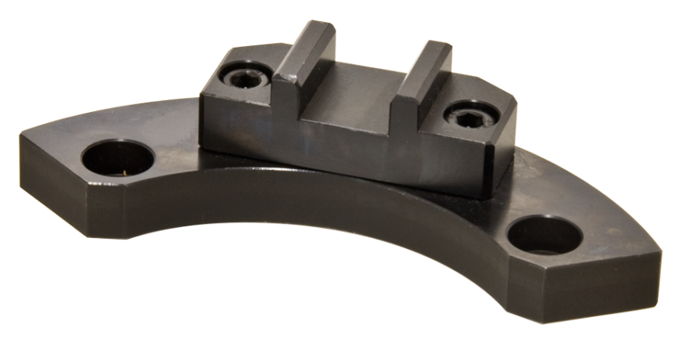
Positioning block
Handmade
positioning block
Notes:
30”
(30”)

Slide 8
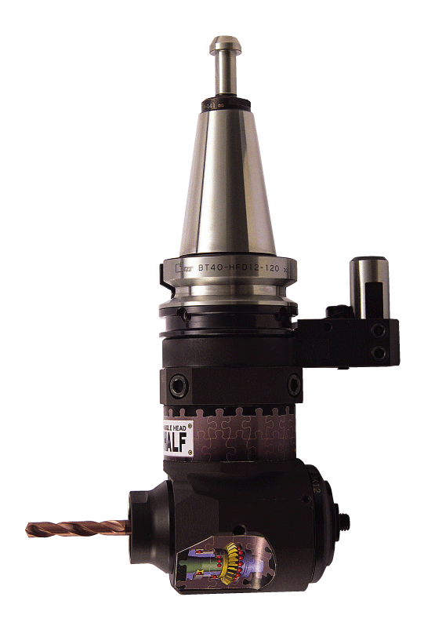
Angle Head Half
Instant delivery !
Immediate use !
Notes:
30”
(30”)

Slide 9
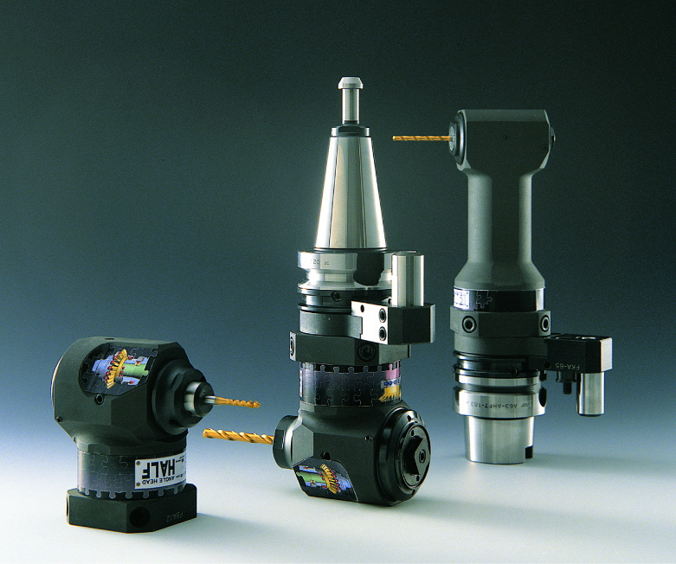
Notes:
20”
(7’35”)

